Slide 1


Planning Process and Hazard Analysis
TNM Jain MSM OMM CD MD MSc

Slide 2
Objectives
Steps to Medical Action Plan Procedure using mass gathering as an example
Learn hazard analysis using SMUG and FEMA models
Site visit/Medical recce

Slide 3
Steps to the M.A.P.
(medical action plan)
1) Define the Event
2) Aerial/Map Recce
3) Conduct hazard and risk analysis
4) Issue initial direction to organization
5) Time estimate
6) Outline plan
7) Medical Recce Plan and site visit
8) Prepare Medical Action plan document
9) Execute Plan
10)AAR
Points:
Coordinate Preparation
Supervise deployment of team

Slide 4
1) Define the event
Agencies involved
Type of event
Duration
Alcoholic beverages
Screening for drugs
Attendance levels
Demographics of attendees
Transportation methods
EVENT HISTORY
  Medical usage rates
  Transports
  Hospital locations
  After action reports

Slide 5
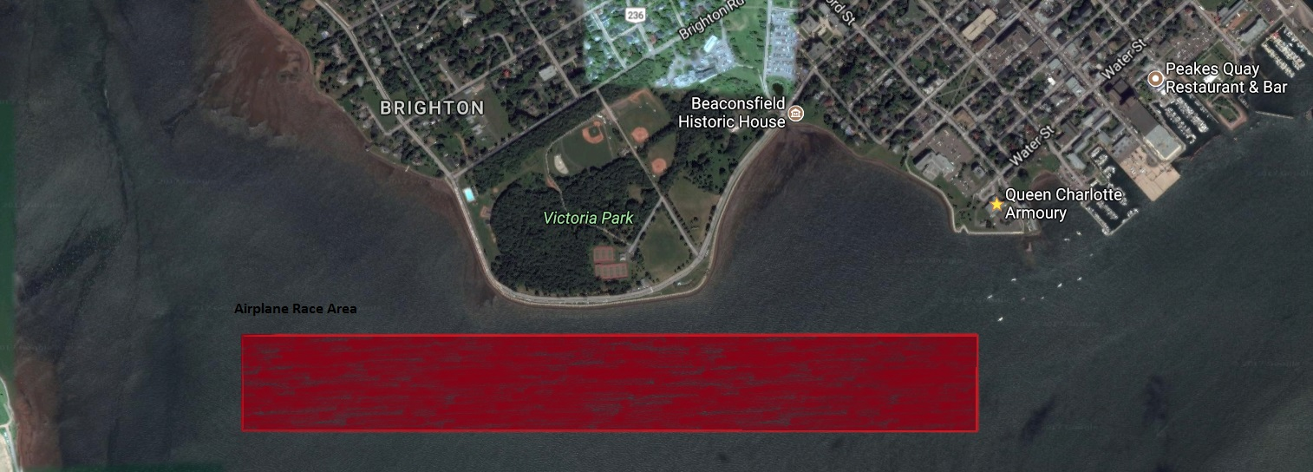
2)Aerial Map/Map Recce
Topography
Site diameter/circumference
Access/egress routes
Comms challenges
Hazards and mitigation

Slide 6
Case
You will be the medical incident commander to manage 60,000 people who will be watching the Red Bull Air Race
You will draft a plan to manage medical expectations for the attendee and developed a MCI plan (MAP) complete

Slide 7
3) Conduct hazard and risk analysis
SMUG? FEMA? History
So what?
  Fuel
  Airplanes
  Vehicles
  Pyro
  Density
  Traffic
  Weather
Has the situation changed
Assigned tasks
Constraints
Clarification

Slide 8
4) Issue initial direction to organization
Described the situation
Probable tasks
Time and location of formal direction
Special instructions
Administration

Slide 9
5) Time estimate
Work back words from the date indicating mile stones of completion of your plan
1430 hrs Teach class
1400 hrs ensure A/V works
1300 hrs leave for UPEI
1200 hrs Lunch
0900 hrs University Admin

Slide 10
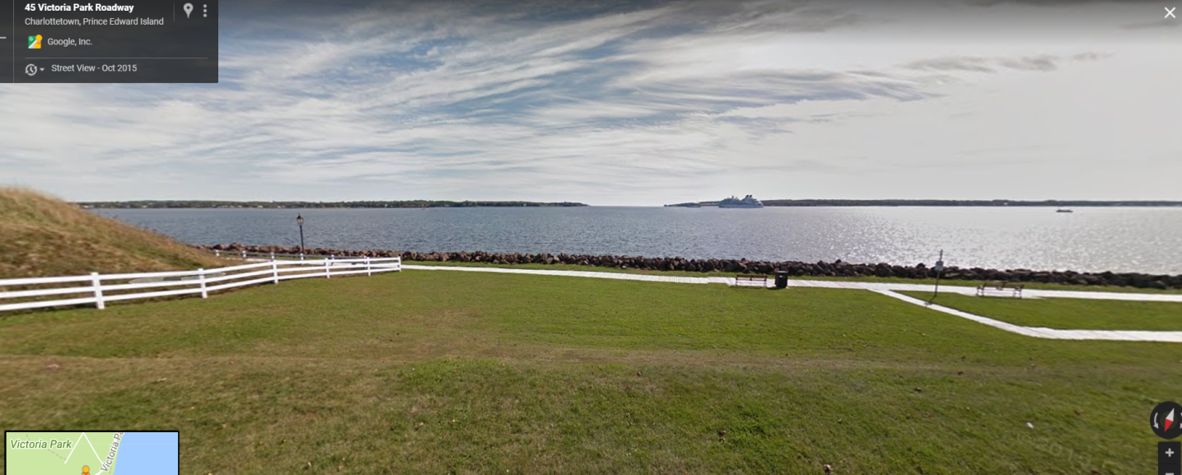
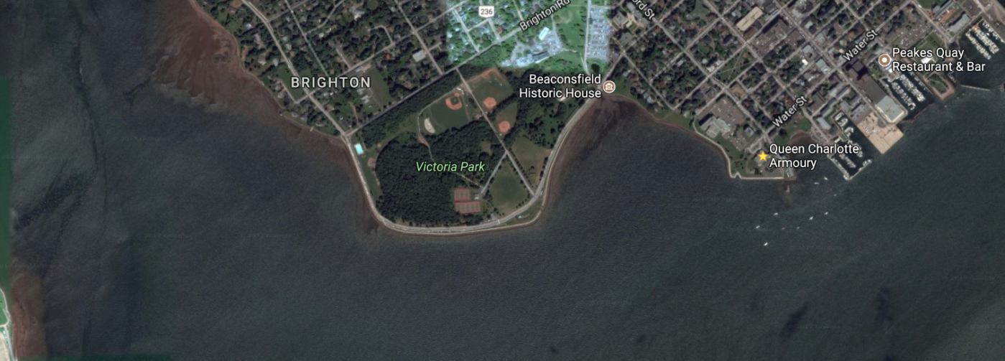
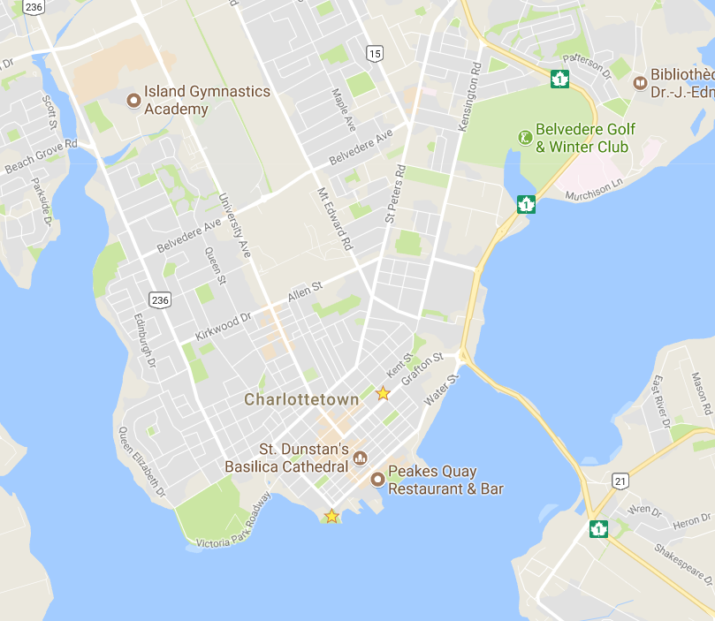
6) Outline Plan

Slide 11
7) Medical Recce Plan/site visit
What do you want to see.
How long for the total recce.
How long are you going to spend on each item.
Total time 1 hour
AMP: 10 min
Triage area: 10 min
Treatment area: 10 min
Transport area: 10 min
Grandstand: 10 min
Vendor area: 5 min
Ablutions: 5 min

Slide 12
7) Medical Recce Plan/site visit
Identify topography
Site diameter
Access/egress routes
Aid posts, roaming medical teams and on site hospitals
Plan location of access/egress routes for ambulances
Campsite

Slide 13
8) Prepare and issue Med Document
What’s in it?
How to brief

Slide 14
8) Medial document content
Situation
Aim
Concept of Operations
Groupings and taskings
Coordinating instructions
Feeding
Dress
Equipment
Internal medical
Attachments
IC location
Who is triage
Who is treatment
Who is transport
Comms:
  PACE
Time check

Slide 15
8) Prepare and issue medical document
Everyone there
Brief
Map model
Limit questions to after presentation
Met briefing

Slide 16
8) Prepare and issue Med Document
Map model
Orientation north
Give direction and distances as you point them out
Terrain features
Hospitals
Police stations
Fire stations
Communication hubs
Cell phone coverage
Lakes, rivers, swamps
Towns, cities
Factories
Location of ICP, other agencies etc.

Slide 17
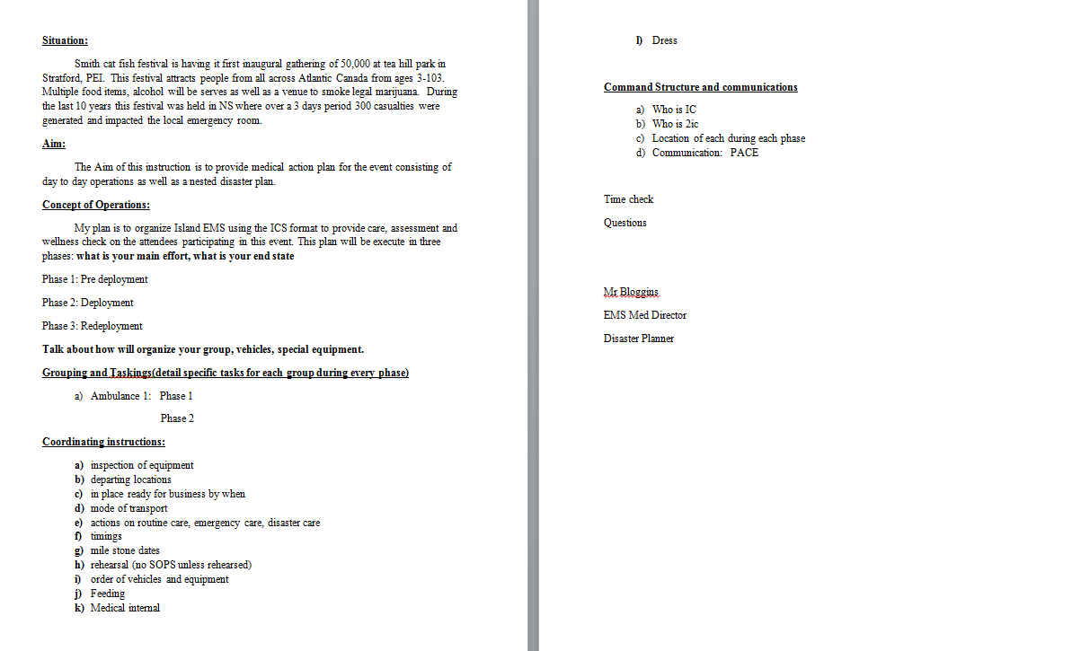
SIMPLE example of med plan

Slide 18
Remember
Then med briefing is a need to know summary to your personnel of your medical action plan document that you prepared
Contains both routine care and disaster care
Contains SMUG/FEMA
Casualty Flow Routine, emergency, disaster
ICS Structure
Comms diagram
Budget etc.

Slide 19
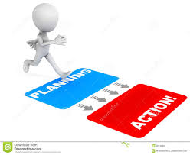
9) Execute plan
Stay on time
Stay on target
Well rested
Well fed
Well hydrated
Take notes as the plan unfolds
Note constraints
Note limitations
If something good happens document
Nomination for Bravo Zulu’s

Slide 20

10) AAR: after action report
What went right?
What went wrong?
What would I change?
Do 180
Do 360
Recommendations
Keep it in your tool box

Slide 21
Questions?

Slide 22
Hazards
Why prioritize?
limited community resources
crucial to decide which ones to deal with urgently and which can be dealt with later
Community involvement
  those which will be affected and those required to take action
Different tools one can use

Slide 23
SMUG Hazard Priority System
SMUG: seriousness
manageability
urgency
growth

Slide 24
SMUG Hazard Priority System
Direct comparison of a number of possible hazards through ratings of high, medium or low against four separate factors which are common to all hazards

Slide 25
FEMA model
Uses four criteria in an evaluation and scoring system, history, vulnerability, maximum threat and probability

Slide 26
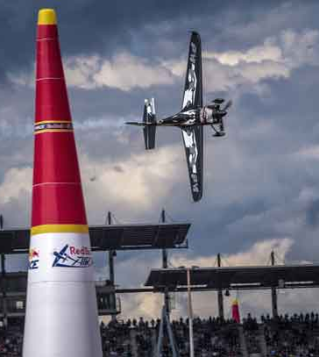
Scenario
Red bull Air Race
May long weekend
60,000 persons over 3 days
Med Recce Plan
Then Med Recce

Slide 28
Site Visit
Med Recce
  AMP
  Triage
  Treatment
  Transport
  IC Post
  Comms

Slide 29
Next class
Using SMUG make a hazard analysis of your own living environment and be prepared to discuss next class
Present you basic home/apartment disaster kit ( what is the source of recommendation )

