Slide 1
Social Media in Disasters and Emergencies
Online survey of 1,017 respondents and
telephone survey of 1,018 respondents.
Report Date: July 10, 2012

Slide 2
Methodology:
Two similar polls were fielded during the period June 14-17 by CARAVAN® ORC International using two methodologies:
  Online Survey of 1,017 respondents representative of the US population aged 18 and older on June 14-17, 2012. Respondents for the online survey were selected from among those who have volunteered to participate in online surveys and polls. The data have been weighted to reflect the demographic composition of the 18+ population. Because the sample is based on those who initially self-selected for participation, no estimates of sampling error can be calculated.
  Telephone survey of 1,018 U.S. Adults 18 years and older on June 14-17, 2012 conducted by CARAVAN® ORC International. Margin of error is +/- 3.1 percentage points at the 95% confidence level.
A telephone methodology is industry standard and data from this sample offer insight into perceptions, behaviors, and expectations of the overall U.S. population. In the following poll summary, telephone survey respondents are referred to as the general population. Data from the online sample give a detailed view of perceptions, behaviors, and expectations of people who spend time online.
Where appropriate, comparisons values have been included from three previous surveys conducted by CARAVAN® ORC International.
  2011 Phone – 1,011 respondents aged 18 and older, conducted on June 24-27, 2011
  2011 Online – 1,046 respondents aged 18 and older, conducted on June 23-26, 2011
  2010 Online – 1,058 respondents aged 18 and older, conducted on July 22-23, 2010
1

Slide 3
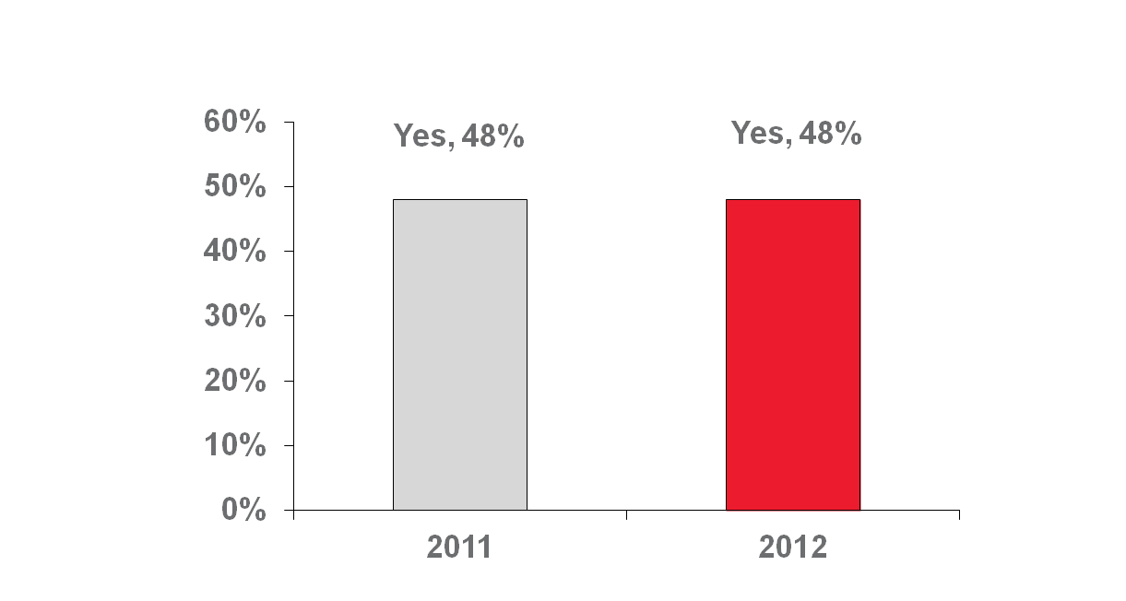
Participation in online communities and social networks remained stable at 48% from 2011 to 2012
Among the general public, those who reside in West are more likely to participate in online communities or social networks compared to those who reside in Mid-West and South.
West 56%
Mid-West 44%
South 45%
Northeast 47%
Do you participate in any online communities or social networks, such as Facebook or Twitter ?
2

Slide 4
For both the general and online populations, differences in who uses social networks are similar.
Respondents with children in the household are more likely to use social media:
  Online: 78% vs. 64% for those without children in the household.
  Telephone: 64% vs. 38% for those without children in the household.
College-educated respondents are more likely to use social media
  Online: 73% for college graduates vs. 57% for those with a high school diploma or less.
  Telephone: 58% for college graduates vs. 39% for those with a high school diploma or less.
Younger respondents are more likely to use social media:
  Online: 85% for 18-34 vs. 60% for 35 years and older
  Telephone: 74% for 18-34 vs. 36% of those 35 years and older.
Do you participate in any online communities or social networks, such as Facebook or Twitter?
3

Slide 5
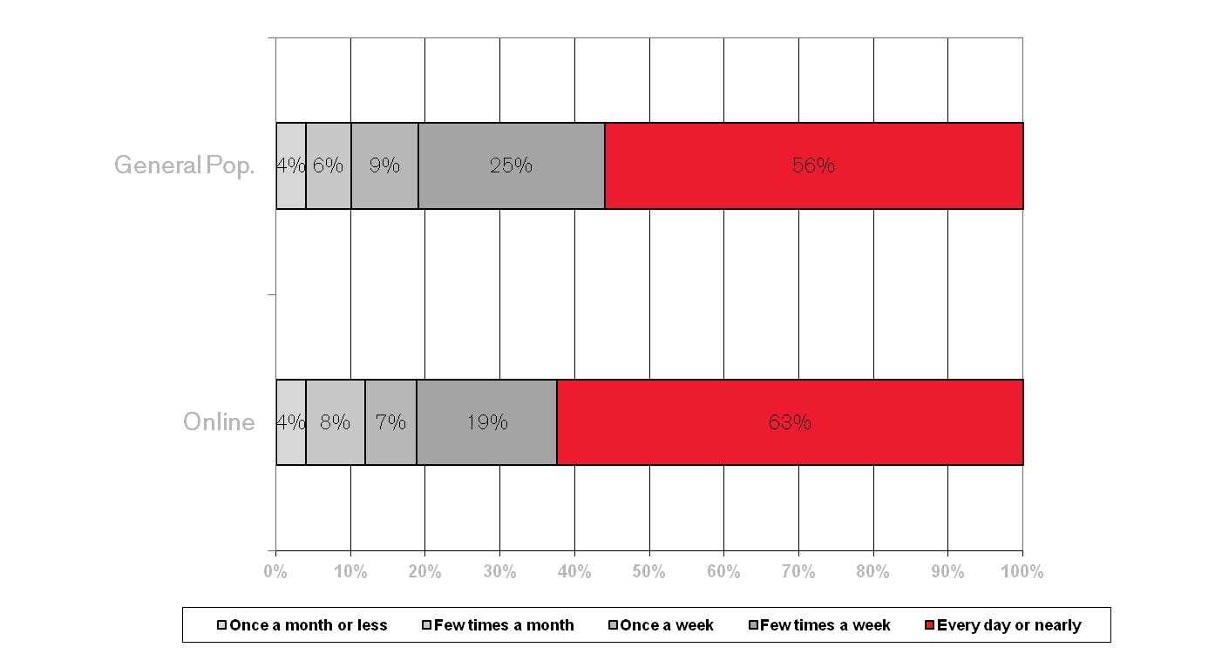
More than half of those who use social media participate every day or nearly every day.
This is roughly the same as in 2011.
Base= 68%(online) and 48% (general public) who participate in any online communities or social networks
How often do you participate in these online communities or social networks?
4
Notes:
Respondents under 35 are more likely to participate in social media every or nearly every day (63% vs. 37% for those 35 and over).

Slide 6
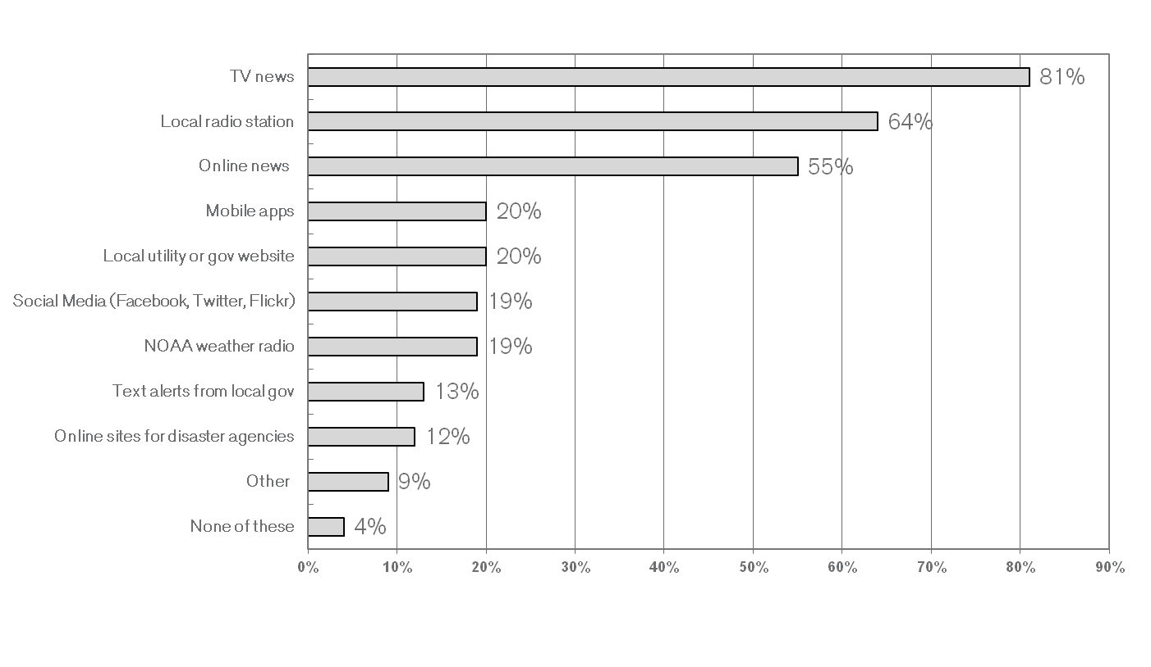
General Public: While TV news is the preferred source of emergency information, more than half of the general public relies on online news.
General public: Younger respondents are least likely to use TV.
General Public:
18-34 75%
35 and above 85%
Which of the following communication channels have you ever used to get information about an emergency such as a power outage, severe weather, flash flood, hurricane, earthquake, or tornado?
5
Notes:
Older respondents are more likely to turn to TV news (73% for those 55+ years old vs. 59% for those under 55 years old).

Slide 7
General Public: Reliance on various communication channels has declined.
Reliance on mobile apps, Facebook, Twitter,and Flickr has remained stable.
Which of the following communication channels have you ever used to get information about an emergency such as a power outage, severe weather, flash flood, hurricane, earthquake, or tornado?
6
Notes:
6
Older respondents are more likely to turn to TV news (73% for those 55+ years old vs. 59% for those under 55 years old).

Slide 8
8 percent of the general public and 10 percent of the online population have downloaded a smartphone app that could help in a disaster or emergency
Most Popular Emergency Apps
Weather Forecasting App 82%
Flashlight App 52%
First Aid App 31%
Police Scanner App 26%
Disaster Preparedness App 19%
General Public:
14% of 18-34 year olds have downloaded an app that could help in a disaster or emergency.
Men are more likely to download an app (10% vs. 6% for women)
What kind of app did you download? Would you say… (Select as many as apply)
Base for Percentages = Combined online (111) and general public (66) respondents who have ever downloaded a smartphone app that could help in a disaster or emergency situation
7

Slide 9
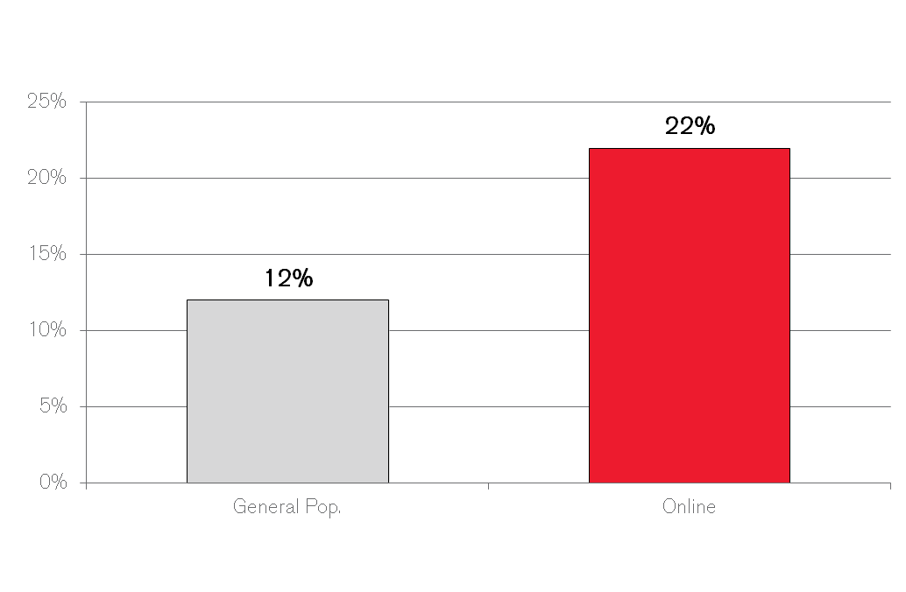
12% of the general public has used social media to share or get information during an emergency, disaster or severe weather event
These respondents will be described as emergency social media users in subsequent slides.
Among the general public, compared to High School graduates or less, College graduates are more likely to use social media to share or get information during an emergency, disaster, or severe weather event:
18% vs. 7% for High School graduate or less
Have you EVER used social media to share or get information during an emergency, disaster, or severe weather events?
8
Notes:
Respondents under 35 years old were more likely to post an eyewitness event (33% vs. 10% for those 35 and over).

Slide 10
Emergency social media users are most likely to seek information about weather, traffic, and damage caused by the event
Most likely to seek information about --
Weather conditions or warnings 79%
Road or traffic conditions 64%
Damage caused by the event 62%
The location or status of loved ones 56%
Also interested in --
Information about how others
are coping with the disaster 49%
Eyewitness photographs 45%
What to do to keep yourself safe 29%
Less likely to seek information about which stores have emergency supplies in stock 15%
What types of information were you seeking? Was it information about… (Select as many as apply)
Base= Combined online (205) and general public (94) respondents who participated in any online communities or social networks & ever used social media to share or get information during an emergency, disaster or severe weather emergency
9
Notes:
Respondents under 35 years old were more likely to post an eyewitness event (33% vs. 10% for those 35 and over).

Slide 11
Emergency social media users are most likely to share weather information, reassurance of safety, and feelings about the emergency.
Most likely to share information about --
Weather conditions or warnings 58%
Reassurance that you were safe 55%
Your feelings or emotions about what was happening 55%
Also likely to share –
Your location 45%
What actions you are taking to stay safe 42%
An eyewitness description of something you experienced 40%
Advice about what actions others should take to stay safe 33%
An eyewitness photo 27%
Less likely to share --
Information about stores or gas stations
that have emergency supplies 16%
A video 15%
Did you share any of the following types of information? Would you say… (Select as many as apply)
Base= Combined online (205) and general public (94) respondents who participated in any online communities or social networks & ever used social media to share or get information during an emergency, disaster or severe weather emergency
10
Notes:
Respondents under 35 years old were more likely to post an eyewitness event (33% vs. 10% for those 35 and over).

Slide 12
Three out of four contacted friends or family members after seeing emergency information on a social media site.
Base= Combined online (205) and general public (94) respondents who participate in any online communities or social networks & ever used social media to share or get information during an emergency, disaster or severe weather emergency
Most chosen course of action --
Contacted friends or family members to see
if they were safe 76%
Other actions taken –
Sought shelter to protect yourself 37%
Purchased or gathered supplies
that you might need 37%
Least chosen course of action --
Downloaded a weather forecasting
app or disaster preparedness
app on your smartphone 25%
Use of online and social media communication tools nearly doubles the number of emergency social media users who act to alert others to an emergency.
When asked if they had called to alert others to the emergency, 42% of the online emergency social media users agreed.
In contrast, when asked if they had acted to alert others to the emergency (no method specified), 81% of the general public emergency social media users agreed.
Have you ever taken any of the following actions based on emergency information that you saw on a social media site? Have you… (Select as many as apply)
11
Notes:
11
Respondents under 35 years old were more likely to post an eyewitness event (33% vs. 10% for those 35 and over).

Slide 13
Nearly one third of the online population would try an online channel for help, if unable to reach local EMS.
Method June ’12
Online (e.g. send email, post on website) 30%
Drive 14%
Phone/Cell phone/Home Phone 17%
Social Networking Channels 10%
Text Message 6%
Send someone / Have someone
else contact them 6%
In person / Walk there 5%
Walk to nearest police,
fire or EMS station 2%
CB Radio / Ham radio 2%
Imagine that someone you know needs help urgently and you haven’t been able to reach the local emergency medical services, police or fire department by telephone. What other ways would you try and get in touch with local emergency services to ask for help? (Open ended)
12
Notes:
Respondents under 45 years old, those from households with three or more people and those with children were more likely to use social media to inform of their safety.

Slide 14
Most trusted sources on social media are local emergency officials, the news media, and family and friends.
Most trusted sources --
Your friends and family 80%
News media or reporters 79%
Local emergency officials 77%
Also trusted --
Federal agencies such as FEMA or
the Department of Homeland Security 65%
The local American Red Cross chapter 60%
Least likely to trust --
People you don’t know who are
in the general area of the emergency 41%
Generally, online respondents have less trust in all sources of social media information.
If you were relying on information from social media during an emergency, which of the following sources of information would you consider trustworthy? Would you say… (Select as many as apply)
Base= Combined online (205) and general public (94) respondents who participated in any online communities or social networks & ever used social media to share or get information during an emergency, disaster or severe weather emergency
13
Notes:
Respondents under 35 years old were more likely to post an eyewitness event (33% vs. 10% for those 35 and over).

Slide 15
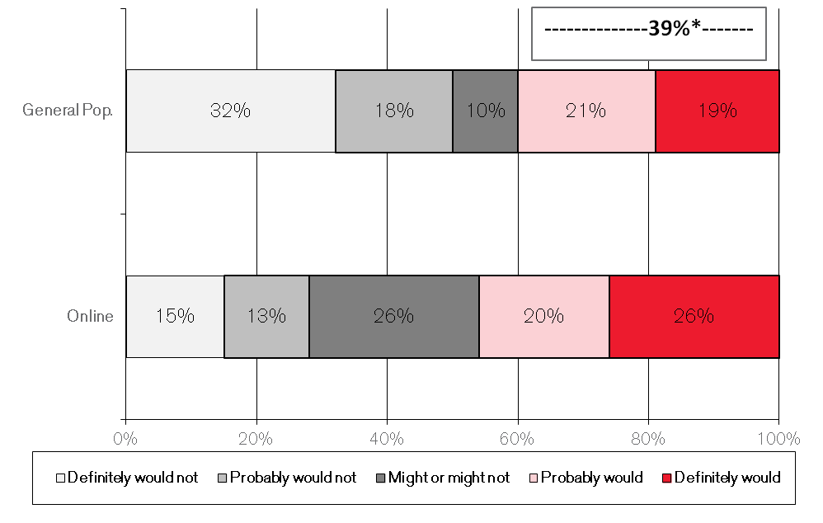
Four in ten members of the general public would use social media to let loved ones know they are safe.
Households with children are more likely to use social media channels to inform of their safety.
with without children children
General 51% 32%
Online 60% 40%
For general public, women are more likely to use social media channels to inform of their safety: 43% vs. 35% for men
(Note: Percentages indicate those who definitely would or probably would)
-------------------46%----------------
Percentage of respondents who would use social media to let loved ones know they are safe have declined
June ’12 June ‘11
General 39% 46%
Online 46% 54%
(Note: Percentages indicate those who definitely would or probably would)
*Note:1% difference due to rounding
In an area-wide emergency, how likely would you be to use social media channels, such as Facebook or Twitter, to let your friends and family know you are safe?
14
Notes:
Respondents under 45 years old, those from households with three or more people and those with children were more likely to use social media to inform of their safety.

Slide 16
At least a third of the general public would expect help to arrive in less than one hour if they posted a request for help on a social media website.
Compared to last year, among the general public, more respondents expect help to arrive in 3 hours or less:
June ’12 June ‘11
76% 68%
*Note: Percentage is sum of respondents who answered “Less than one hour” and between “One to three hours”
Among the online respondents, women are more likely to expect help to arrive in less than 1 hour:
45 percent vs. 37 percent for men
If you posted a request for help to a social media website, how much time do you think it should reasonably take for help to arrive? (Open-ended)
Note: For the online survey, question formatted to accept a range of 0-72 for hours and 0-59 for minutes.
15

Slide 17
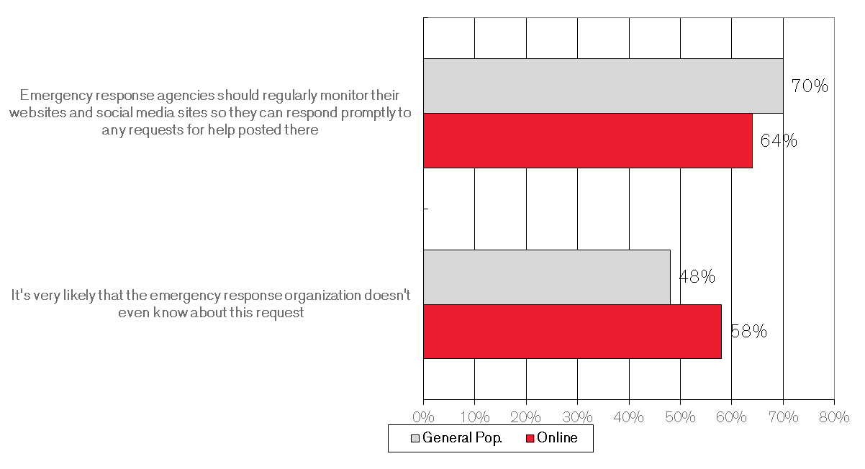
While the majority in both populations feels that local emergency response organizations should regularly monitor their websites for emergency requests, roughly half of the general public and 58 percent of the online population doubt that they do.
Among the general public respondents, expectations for regular monitoring by local emergency response organizations are lower in the West Region
Percent
North-east 73%
Mid-west 74%
South 74%
West 57%
Note: Percentages indicate those who strongly agree or agree
Note: Percentages indicate those who strongly agree or agree
Imagine that you posted an urgent request for help on a social media site of a local emergency response organization such as your local emergency management, fire department or police department. To what extent do you agree or disagree with the following statements? Split Sample
16

Slide 18
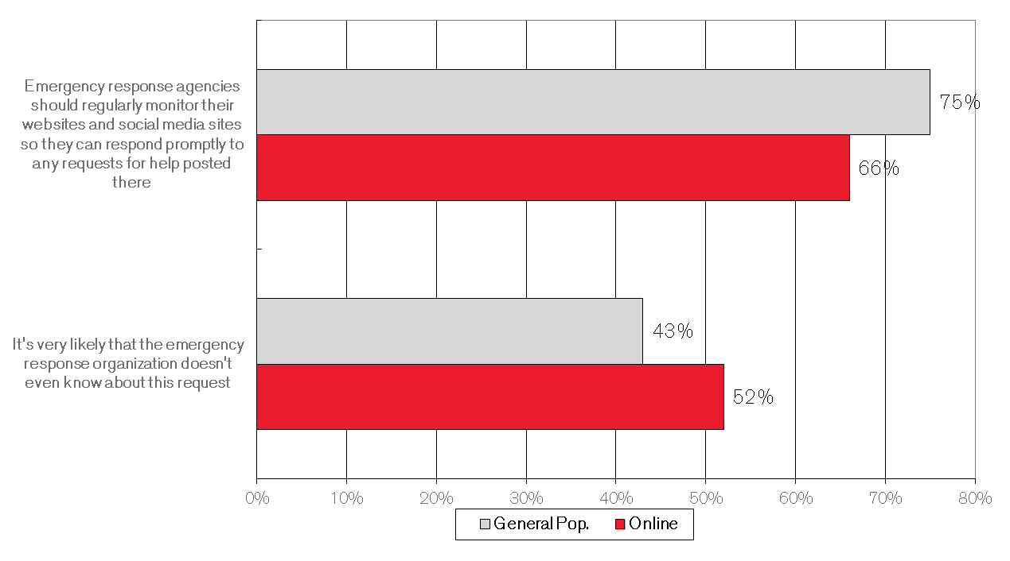
Among the general public, expectations are higher for national emergency response organizations, as three in four expect regular monitoring.
Compared to last year, expectations have declined. However, doubt has also declined.
June ’11
Expectation:
General 80%
Online 69%
Doubt:
General 49%
Online 60%
(Note: Percentages indicate those who strongly agree or agree)
Note: Percentages indicate those who strongly agree or agree
Imagine that you posted an urgent request for help on a social media site of a national emergency response organization such as FEMA or the American Red Cross. To what extent do you agree or disagree with the following statements? Split Sample
17

