Slide 1
Health Care Facility Management
Trevor Jain OMM MSM CD MD MSc

Slide 2
Overview
Low priority
Formalized preparedness started in the UK
Really gained momentum during WW2
UK: 12 regions
London 12 Sectors
Nurse training act
Notes:
-Traditionally a low priority, Formally started in the UK, days prior to outbreak of hostilities in WW2
-UK was divided in to 12 regions with London being divided in to a further 12 sectors with heavy population densities
-passed the nurse training act requiring allowing females who were 17 years og age to apply which in turn for education would serve anywhere the government needed them to, program trained 124,000 nurses

Slide 3
History
Cold War
Modern Era
Civil defense act Congress focused on massive CRBN casualties
Created field hospitals allowing for ½ million surge capacity
Allowed a 7,800 operating rooms
Center for public Health Preparedness required physician knowledge of
Triage protocol
Antidotes and vaccines
Community resource linking
Assess and implement a local disaster plan
Patient information
Ethics and rationing

Slide 4
Emergency Management Committee
Facilities EMC should be given the task of:
All hazard emergency plan
Perform a hazard vulnerability analysis (HVA)
Coordinate: fire, police, public health, public works, EMO, EMS
Coordinate with the medical staff and each department of the facility
Assist in training stakeholders in the plans it develops

Slide 5
EMC
Administration
Medical staff
Nursing department
Emergency department
Security department
Environmental
Plant operations
Materials management
pharmacy
Materials management
Pharmacy
Lab
Rad
Ancillary services
Food service
Volunteer service
Notes:
Hospital leadership should pick a keen person who is interested in the topic with the above representation

Slide 6
Notes:
Use the same model for disaster management for facilities as you do for the bigger picture

Slide 7
Mitigation
Activities that can be undertaken, pre disaster or emergency to lesson the severity of an event
Measures that will reduce the potential physical damage to the facility during an event

Slide 8
Preparedness
Activities, programs, systems that are in place before the disaster or emergency and that are used to support the response to the event thus creating inherent capacity for the response

Slide 9
Response
Activities undertaken to address the immediate and short term effects of a disaster or emergency

Slide 10
Recovery
Activities and processes that must be undertaken to restore pre-disaster normality to the individual, facility or community that experienced a disaster or emergency

Slide 11
Hazard Vulnerability Analysis
Process used to identify those risks in the community that could cause an interruption or loss of critical function or service, cause casualties and possibly damage the hospital’s physical plant

Slide 13
Notes:
An example of Hazard Vulnerability Assessment Tool For Environment Events

Slide 14
Common Factors in Disasters for Health Facilities
Uncertainty
Casualty arrival
Communication
Patient care capacity
Staffing
Blood products
Medical Equipment
Service Deliveries
Security
Care of relatives and friends
Damaged Hospitals

Slide 15
How do you organize the hospital response?

Slide 19
Hospital Physical Plant Preparedness
Electrical
Heating, Ventilation and Air conditioning
Water
Damage control
Supplies
Communications
Notes:
Electrical: codes exist that require that emergency generators support and the hospitals electrical power requirements for patient care
Heating, Ventilation and Air conditioning: first consideration is the location of air intakes for the hospital, because many chemical are heavier than air, ground level air intakes are particularly susceptible to drawing in contamination. Best location is on the roof
Water: absolute necessity to keep the hospital functioning. EMC should determine whether the utility company feeds water to the hospital in two different directions, hence is one water breaks another is available: redundancy is the key
Damage control: damage control plan between EMC and plan operations, compiling a list of damage and then listing priorities for it to be fixed (done by the IC and the chief of operations section)
Supplies: WEAKNESS; just in time inventory, great from a financial standpoint but unreliable in a disaster situation especially on e that convers a large geographically area
Communications: recurring issues in most disasters, EMC review existing communication systems in the hospital such as telephone, paging, computer systems, if the hospital uses web based if internet fails need an auxiliary system muct be available. If too many individuals use regular phones or even satelite phones it will overwhelm the system. Alternative is for hospital to purchase hand held radios. Social media can be useful tool but also creates a risk that inaccurate and contradictory information

Slide 20
Surge capacity
Capability: To rapidly expand the capacity fo the existing healthcare system including long-term care facilities, community health agencies, acute care facilities, alternate care facilities and public health departments in order to provide triage and subsequent medical care

Slide 21
Evacuation

Slide 22
Evacuation
Horizontal versus vertical evacuation
Use check lists
May have plans for stages and total evacuations
Notes:
Horizontal evacuation: moving from one part of a floor to another perhaps behind a fire barricaded door
Vertical: evac from one floor up or down or even from the facility

Slide 23
What are the available resources?
Staff (trained, personnel, availabilty)
Stuff (supply chain)
Space(capacity-critical departments)
System (procedures and protocols)
$ (budget)

Slide 24
What information do you need to execute your planned response when the disaster happens?

Slide 25
METHANE
Type of disaster
Number of critically injured casualties
Duration of casualty-generating circumstance
Available infrastructure
Quantity and duration of additional critical care required
Interdependencies

Slide 26
Immediate Actions
Delayed Actions

Slide 27
Immediate actions
Clear the emergency department
Cancel elective procedures and admissions
Increase capacity

Slide 28
Delayed Reactions
Early discharge of stable inpatients
Alternative Care Sites

Slide 29
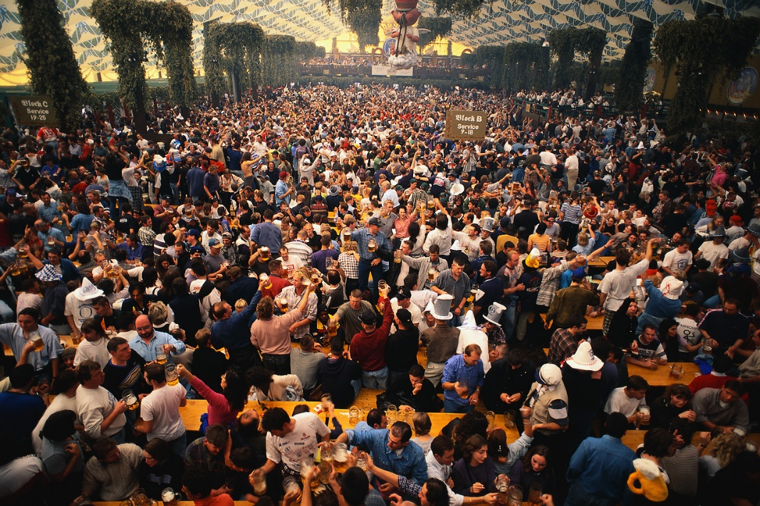
Flux of victims
First wave
minor injuries
to the nearest hospital
overcrowd in ER
+
Regular business at ER!!!

Slide 30
Flux of victims
Second wave
severe injuries (mainly triaged at scene or in AMP)
Third wave
minor injuries (emotional stress)

Slide 32
Do not forget:
There will be also media and relatives!

Slide 33
Questions?

